Slide 1
3C147,
Primary Beams,
Pointing Errors,
&
The QMC Project
O. Smirnov (Rhodes & SKA SA)

Slide 2

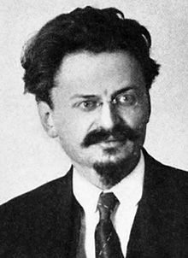
Happy Valentine's Day!
All you need is love!
...and revolution.
...and polarization.
...and A-projection.

Slide 3
Calibration 101
3C147 exercise
  cp -a /home/data/cal .
  cd cal
Load calico-stefcal.py
Make a dirty image from the DATA column

Slide 4
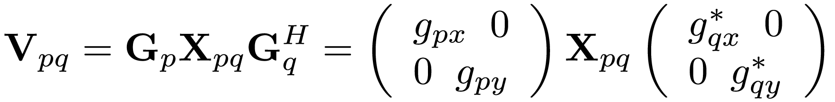
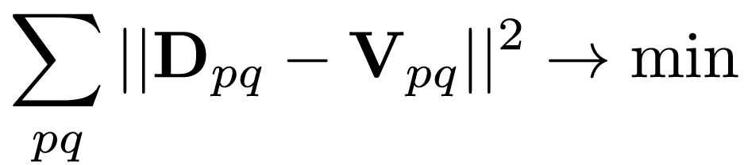
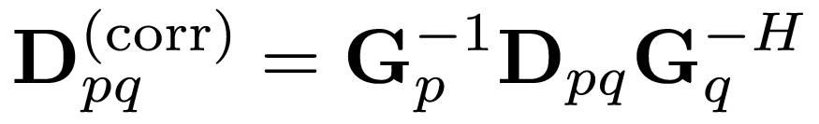
Basic Calibration Concepts
“predict”
“gains”
“model
sky”
“data”
“Calibrate” =
find G:
“Correct”:

Slide 5
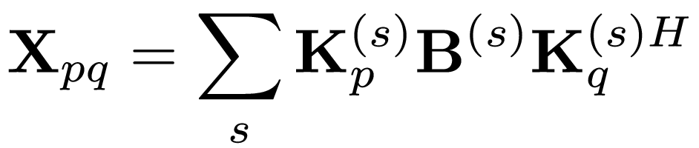
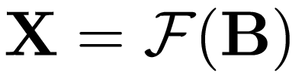
Sky Models
Sum of delta functions:
...or pixellated image:
...or Gaussian components, or shapelets, or wavelets, etc.
...or any combination of the above

Slide 6
Selfcal
Start with prior sky model X
Solve for G gains
Correct data & image
Update X to fit corrected image
Rinse, repeat
  (and for this exercise we'll cheat and start with a “complete” sky model)

Slide 7
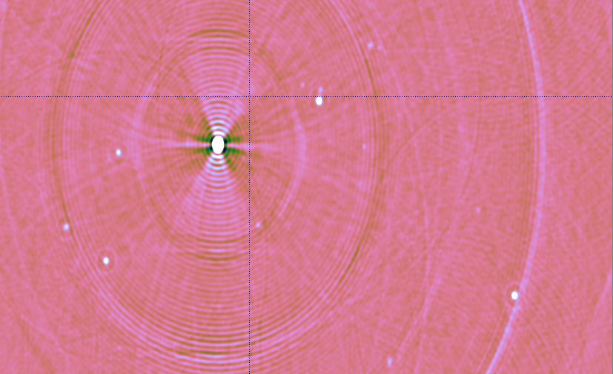
Exercise 1
Run calibration, produce corrected data
  Look at inspectors...
Make image of CORRECTED_DATA
CLEAN?

Slide 8
Residuals
Corrected image still dominated by 3C147, even post-convolution
Better to look at “corrected residuals”:
(“what's left in the data once we've taken the known model out”?)

Slide 9
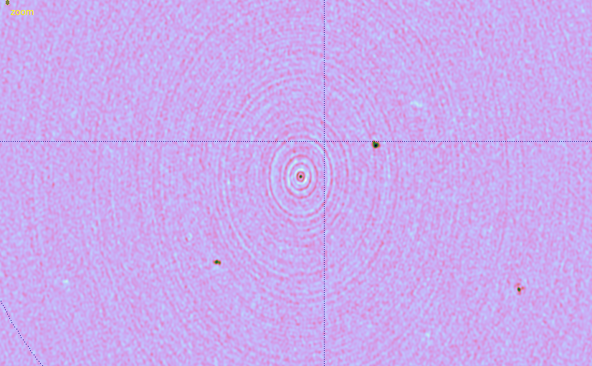
Exercise 2
Run calibration, produce corrected residuals
  Look at inspectors...
Make image of CORRECTED_DATA
CLEAN?

Slide 10
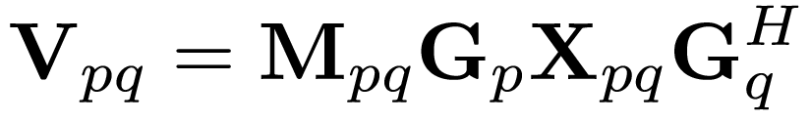
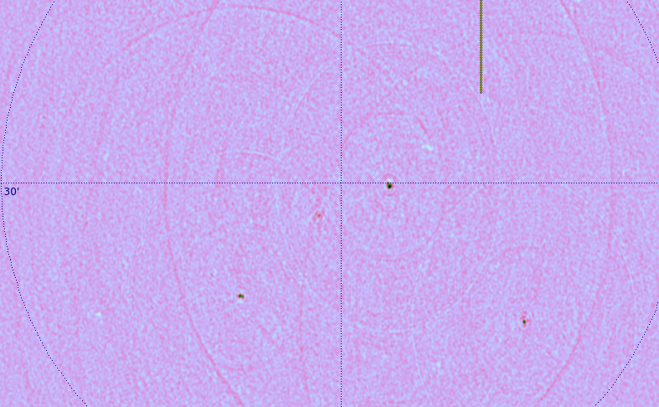
Exercise 3
Interferometer gains (ifr-based errors):
Solve for M's over the entire dataset
  (if we solve for it at finer timescales, then any sky model can be made
  to fit any data!)
Happens on-the-fly,
just re-run the
calibration to apply

Slide 11
Exercise 3a
What happens if we have an incomplete sky model?
Under “Tigger Sky model”, select “Source subset: A*”
Repeat calibration & make a clean image

Slide 12
Repeat For 8 Bands...
This was for one band out of 8
Now need to repeat for other 7, and combine the images...

Slide 13

3C147
NEWSTAR image
22Jy @21cm
12h, 8 bands
13.5 uJy noise
on-axis DR:
1500000:1
off-axis DR:
1000:1
Limited by direction-dependent effects
polarized, 40 mJy
3C147, 22 Jy
35 mJy
20 mJy

Slide 14
Calibrating For DDE's:
Peeling
“Peeling” is different things to different people, but here we'll define it as:
  selfcal on brightest source, subtract source
  shift phase center to next source
  selfcal, subtract, rinse & repeat
Proven to work...
  3C343, 3C84, 3C196, etc. (Ger de Bruyn, Tom Oosterloo, Michiel Brentjens – NEWSTAR, Miriad)
...but cumbersome to use (miles of scripts)

Slide 15
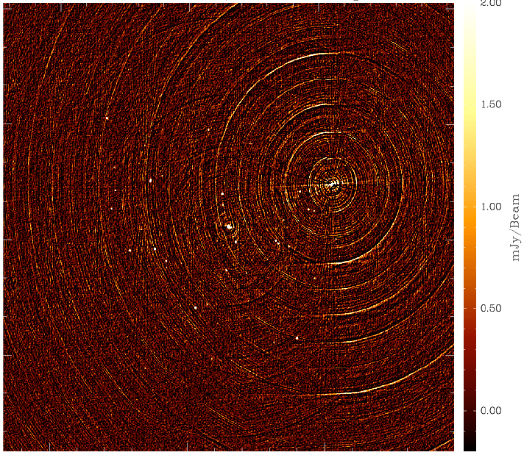
3C343: A Typical
Peeling Candidate

Slide 16
Calibrating For DDE's II:
Beyond Peeling
Weakness of peeling: interacting solutions when sources have comparable flux
  need to iterate back and forth
  Not clear how deep one can go
Alternative: simultaneous off-axis gain solutions (some call it “peeling” too.)
Alternative: solving for pointing errors
  Sanjay Bhatnagar – talk later
  EVLA Memo 84

Slide 17
The Measurement Equation Approach
Implement calibration via a Measurement Equation. For example:

Slide 18

Seeing The DDE's
Residual image, 298 sources subtracted
Per-channel selfcal + closure errors
Dominant features are residuals from off-axis sources.
Some of it is due to missing/too much flux in the sky model and can be CLEANed away.
But not all of it! (and this is what causes artifacts in the final map.)
polarized, 40 mJy
3C147, 22 Jy
20 mJy
35 mJy

Slide 19
Solving For Pointing Errors
Bhatnagar's approach, in terms of our ME:

Slide 20
Differential Gains
Or we can introduce differential gains:

Slide 21
Flyswatter I
The “before” image.

Slide 22

Flyswatter II
Solved for ΔE for
5 sources.

Slide 23

Flyswatter III
Solved for ΔE for
10 sources.
In the end 10 sources proved unnecessary (deconvolution helps as well!), so in the final images I only solved for 6 sources.

Slide 24
3C147
NEWSTAR image
22Jy @21cm
12h, 8 bands
13.5 uJy noise
on-axis DR:
1500000:1
off-axis DR:
1000:1
Limited by direction-dependent effects
(DDEs) such as pointing errors, tropospheric refraction, etc.
No direct cure in selfcal.

Slide 25

3C147
MeqTrees image
22Jy @21cm
12h, 8 bands
13.5 uJy noise
Same DR as NEWSTAR, but no off-axis artifacts.

Slide 26
Differential gains: The Downside
“no sources, no problem” – but are we overfitting?
  per-channel selfcal (14 antennas, 85 baselines):
  14 complex gains per t/ν point,
  85 complex measurements per t/ν point
  one extra ΔE term:
  14 complex gains per 60*30 t/ν points,
  ~.008 of a parameter per t/ν point, per source (x6)

Slide 27
Differential gain analysis
For each source/antenna, we have independent ΔE solutions per each band (8), per 30 minutes.
Studying the t/ν behaviour should tell us something about:
  whether we have solved for a physical effect,
  the nature of that effect.

Slide 28

Note the high S/N in frequency
Continuity in time and space suggests dominant large-scale effect, as opposed to per-antenna things like pointing

Slide 29
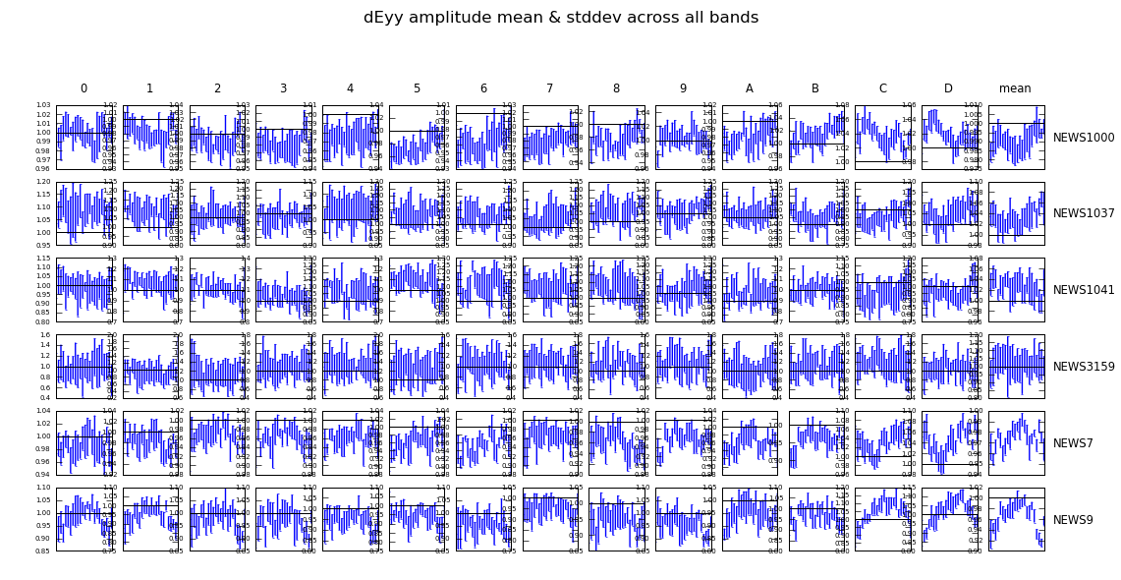
We can solve for DDEs with relatively weak (~few mJy) sources!
Good news for calibration of future instruments: we should have enough calibration beacons.
(Noordam conjecture: if it's bright enough to cause trouble, it's bright enough to be solved for.)

Slide 30

Final Image
3C147 @21cm
Single 12h
WSRT synthesis
22 Jy peak
13.5 μJy noise
1,600,000:1 DR

Slide 31
Differential Gains, Redux

Slide 32
A.k.a. “The Flyswatter”
The Good:
  dE's can completely eliminate contaminating sources, making for great maps!
  See also talks by Ian Heywood, Panos Labropoulos
The Bad:
  Computationally feasible for a “handful” of sources at most
  Proliferation of degrees of freedom
The Ugly:
  Mashes together all information on both the source and all instrumental effects towards it

Slide 33

The Ugly, continued...
...and makes no use of the fact that DDEs must have spatial continuity.
Example: 3C147 field, dE-phase solutions as a function of time, per source, per antenna:

Slide 34
Alternatives:
Fitting a “Global” DDE Model
Pointing selfcal (S. Bhatnagar)
  Uses EVLA PB model, with a solvable pointing offset Δl,Δm
  First-order approximation to ∂χ²/∂(Δl), ∂χ²/∂(Δm)
  using FFTs and convolutional functions
  Uses entire sky model (image) as input
  Results (so far): seems to improve pointing solutions, but little reduction in imaging artefacts
  Possibly due to inadequate PB model?
AW-projection can apply “global” correction during imaging

Slide 35
The QMC* Project
Pick a field containing a cluster of reasonably bright off-axis sources
Observe with WSRT @21cm
Introduce deliberate (and secret!) pointing errors during observation
Attempt to recover these during the reduction
*) Named in honour of the long-defunct WSRT Quality Monitoring Committee. Yes, the Dutch do love their committees. Fortunately, so do the Russians.

Slide 36
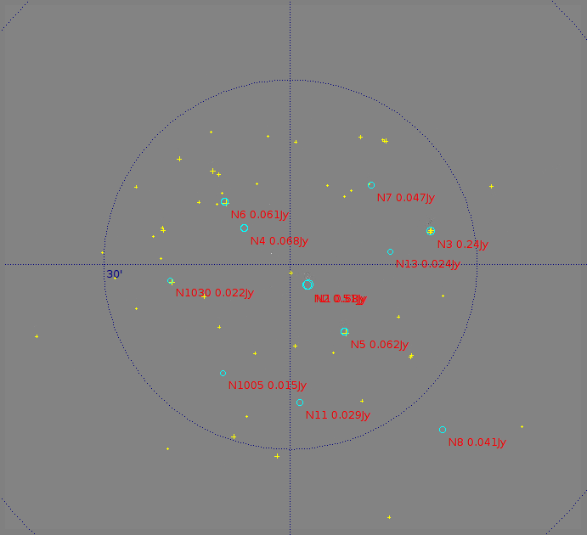
The QMC Field (04518+5045)
Found via an automated NVSS search (Python script...)
1.4 Jy 4C source at center
Unfortunately, many sources proved to be slightly extended, thus complicating matters enormously

Slide 37

The QMC2 Field (01515+6736)
Added at the Observatory's insistence (thanks!)
RA=1h: easy to find WSRT observing time
Dominant sources: 220, 160 mJy
3C source to NW, attenuated by 10⁻³
Most sources are unresolved

Slide 38

Gifts Of QMC2
Initial observation (2010Jul3) was an “error-free” 12h synthesis, in order to build up a sky model
“I have never seen such
a terrible WSRT map!”
– Ger de Bruyn
Differential gains sorted
out the issue as usual

Slide 39


QMC2 2010Jul3 dE amplitudes
||dE|| solutions show large offsets on RT8, consistent with a significant mispointing to the North
Problem was reported to the Observatory, and they discovered a faulty encoder on RT8's declination axis

Slide 40

QMC2 2010Jul21:
Now mispointed
||dE|| solutions suggest a static mispointing of RT2, RT6, RT8
...and a time-variable mispointing of RTB
(“Hans's susprise”)
Hans confirmed that this was consistent with the mispointings he had put in.

Slide 41

“Rogues' Gallery” Plot
Plots of mean ||dE|| per antenna, at proper positions within the field.
Colour/size indicates
||dE||>1, <1.
(Note 3C source at NW!)

Slide 42
Phase II: Solving For Pointing Errors
This was where things stood at the last CALIM
...where Sanjay suggested I should solve for pointing offsets on the same field
A MeqTrees variation on pointing selfcal: DFT pointing solutions.
MeqTrees can “solve for anything”: we need to construct a suitable model where the pointing offsets are parameters, then designate them as solvable and say “go”.

Slide 43
DFT Pointing Solutions

Slide 44

P.E. Solutions (QMC2 2011Jul21)
Recovered solutions consistent with deliberate mispointings, but underestimate them:

Slide 45

Not so impressive...
Residual image,
post-selfcal

Slide 46

A Marginal Improvement
Residual image,
post-selfcal,
with pointing error solutions
(Note how this relative lack of improvement is consistent with Sanjay's pointing selfcal results.)

Slide 47

Nowhere Near The Flyswatter...
Residual image,
post-selfcal,
with differential
gains.

Slide 48
Parameterizing The Beam
The advantage of the DFT approach is that we can introduce other parameters into the primary beam model.
Just as a random example, we can introduce a per-antenna beam scale sp:
And then treat sp as a solvable.

Slide 49
P.E. Solution Only
Residual image,
post-selfcal,
with pointing error solutions

Slide 50

P.E. + Beam Extent
Residual image,
post-selfcal,
with pointing error and beam extent solutions
...not as good as differential gains, but an improvement!

Slide 51


Now Back To The Pretty Plots
Beam extent and pointing offset solutions are strongly coupled
Beam extent solutions are non-physical (±10%!)
More of the poitning
Obviously the extra degree of freedom is compensating for something else, but what exactly?

Slide 52
Compare To The PE-Only Case
P.E. solutions without a beam extent show more variance
...and underestimate the true mispointing to a larger degree
Tentative conclusion: P.E. solutions are limited by the accuracy of the beam model
...as are the final maps
There may also be a directional coupling determined by the configuration of sources in the field.

Slide 53
QMC2 “8-Way” Observations
To check for directional coupling, we asked for another observation of QMC2 with 8 antennas mispointed to 8 points of the compass (by 60 mdeg each)
This was done in March 2011, but due to some problems only 90 minutes of data were taken
Thus no imaging was possible
...but we could still do P.E. solutions
  (we'd been solving at 30-minute intervals before)

Slide 54


8-Way Pointing Solutions
Expected vs. fitted pointing offsets
With a solvable beam extent
Without a solvable beam extent

Slide 55
Know Thy Beams
(and the incestousness of selfcal)
Why not throw more parameters at the beam model?
We do NOT have absolute, intrinsic source fluxes. Selfcal gives us fluxes attenuated by some average primary beam.
Our solution is then only sensitive to differences between antennas (and timeslots).
Given a perfectly-pointed observation and identical PBs, our method is completely insensitive to beamshape.
Pointing errors give us a handle on the gradient of the beamshape.
  (this also explains why the beam extent solutions above are non-physical!)

Slide 56
The Next Step: A QMC2 Mosaic
Latest observation (2011Jul17): a 10-pointing mosaic, ~1 hour per pointing.
1 pointing to field centre,
9 pointings to off-axis
sources around the
half-power point.
8-way mispointed.
Will use this to
simultaneously constrain
source fluxes and PB
models.

Slide 57

Yet Another Twist: Solving For P.E.
On Shorter Time Scales
Solutions every 30 sec, 2.5 min and 5 min.
Longer time scales: decreased variance (higher SNR)
Diminishing returns above 5 min.
Show a striking feature unnoticed on the previous
(30 min.) plots...

Slide 58

And Now, Applying Sophisticated
Model Fitting Techniques...
Westerbork Wobble!
WW

Slide 59

The Wobble
A periodic (~20 min) variation in the pointing of 10-20 mdeg.
Shows up in other observations, on other antennas (to varying extent)
Fourier transform the pointing offsets, and plot the amplitudes of the Fourier components:

Slide 60
Wobbling Across 5 Epochs (RA)

Slide 61
Wobbling Across 5 Epochs (Dec)

Slide 62
Wobbly Features
RA & Dec coupled, Dec wobbles more
Only some antennas wobble
  But they differ epoch-to-epoch
Wobble amplitude varies epoch-to-epoch
  Can reach 20 mdeg (10 is nominal accuracy!)
  Some epochs much worse than others, why? (waiting for wind data)
Wobble period is 5 to 60 minutes
  Quite stable (up to 4 hours)

Slide 63
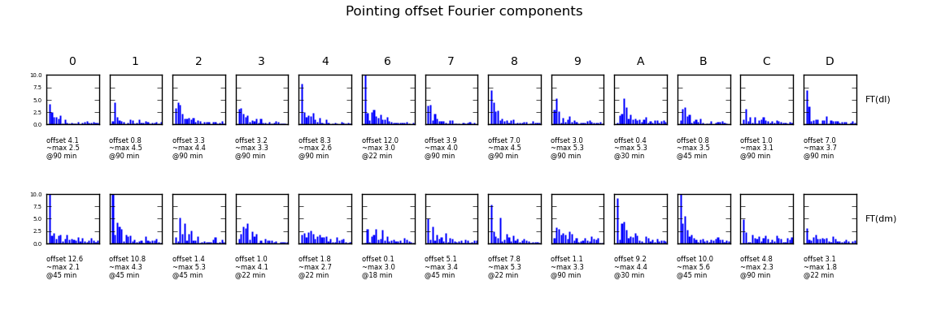
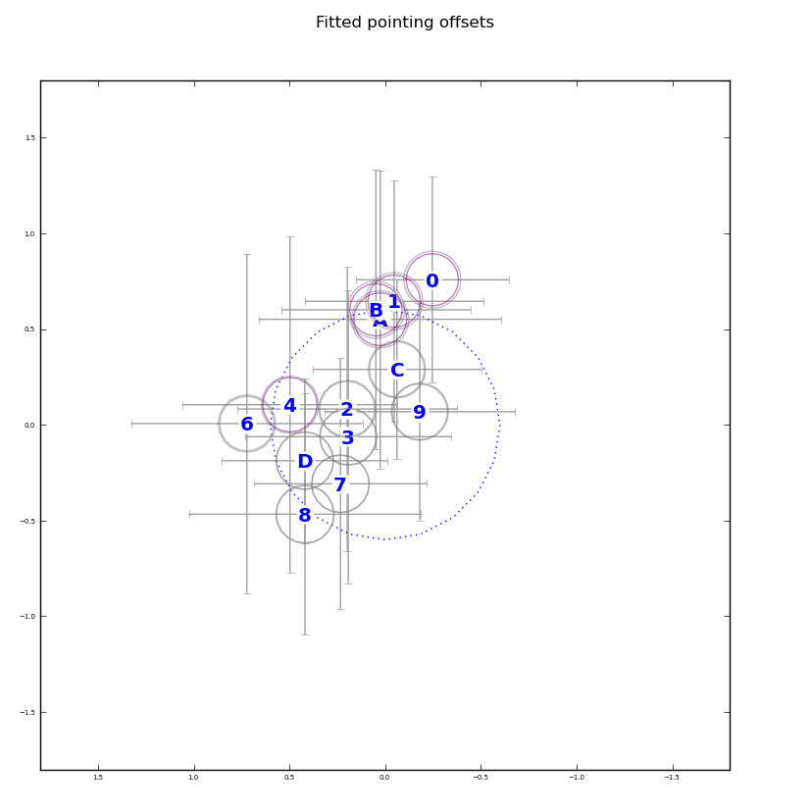
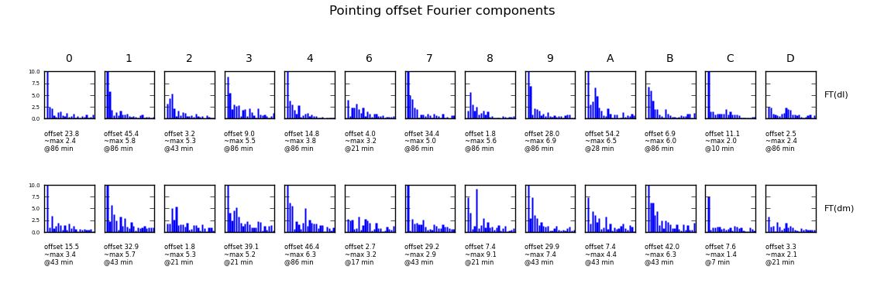
The Promise of a QMC
60 ~ 90 minutes of data is enough to characterize both the static and the dynamic pointing quality.
WSRT schedule always has suitable small gaps

Slide 64
Conclusions I
Differential gains (dE's) can completely eliminate contaminating sources
  ...but only feasible for a few (tens) of sources
“Global model” DDE solutions (pointing selfcal, DFT pointing, etc.) are also feasible
  ...but don't (yet) eliminate artefacts to the same extent
The future is hybrid: high-DR imaging at SKA sensitivities will require:
  dE's (or some variation thereof) on Cat I sources
  “global model” DDE solutions on Cat II sources

Slide 65
Conclusions II
Pointing error solutions are limited by the PB model
  as are the remaining imaging artefacts
KNOW THY BEAMS!
  and we don't, really (so come to Portugal!)
Westerbork Wobbles, and we ought to figure out why (APERTIF is coming)
Would be nice to apply this to other observatories
(Will the VLA Vaccilate? Must MeerKAT Meander?)
I make really bad puns sometimes...

